Slide 1
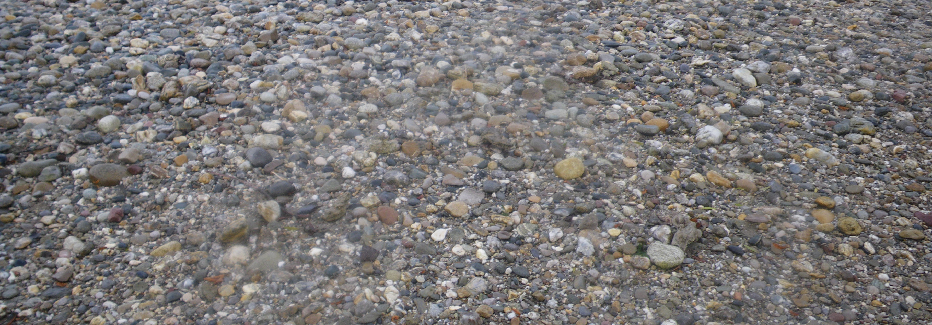
Sediment grain size analyses based on sieving datasets
Python Programming for Water Resources Engineering and Research
Project Framework Presentation
February 09, 2022
Beatriz Negreiros
&
Federica Scolari

Slide 2
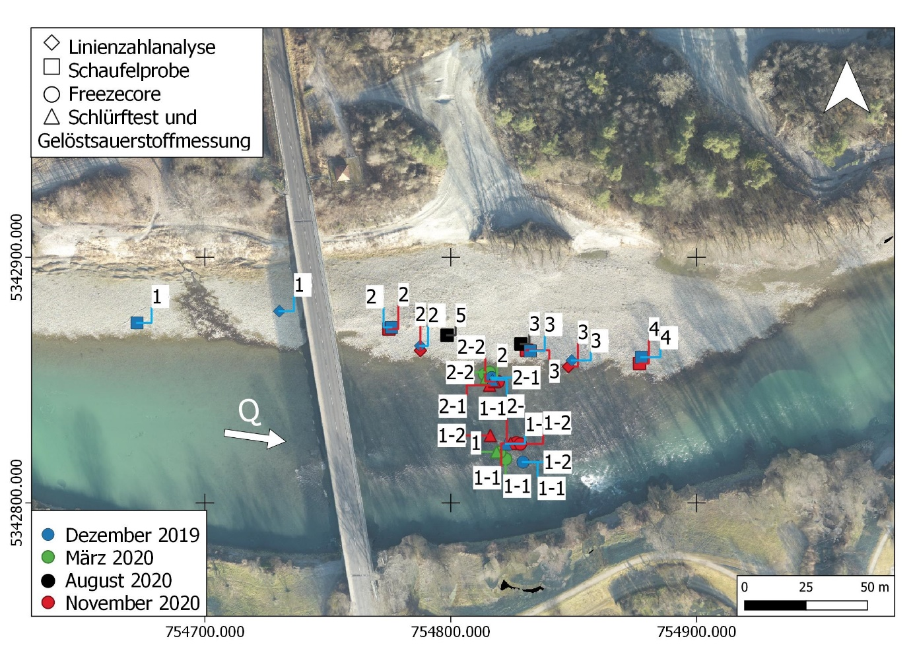
Recall: Project Idea
Overview
Field campaigns are characterized by the collection of massive data that has to be analyzed afterwards.
Currently, the department uses an Excel workbook that computes statistical parameters for each collected sample, which results in heavy analysis files, difficult both to share and work with.
In many cases it is challenging to interpret the results for so many sampled locations without any direct spatial visualization.

Slide 3
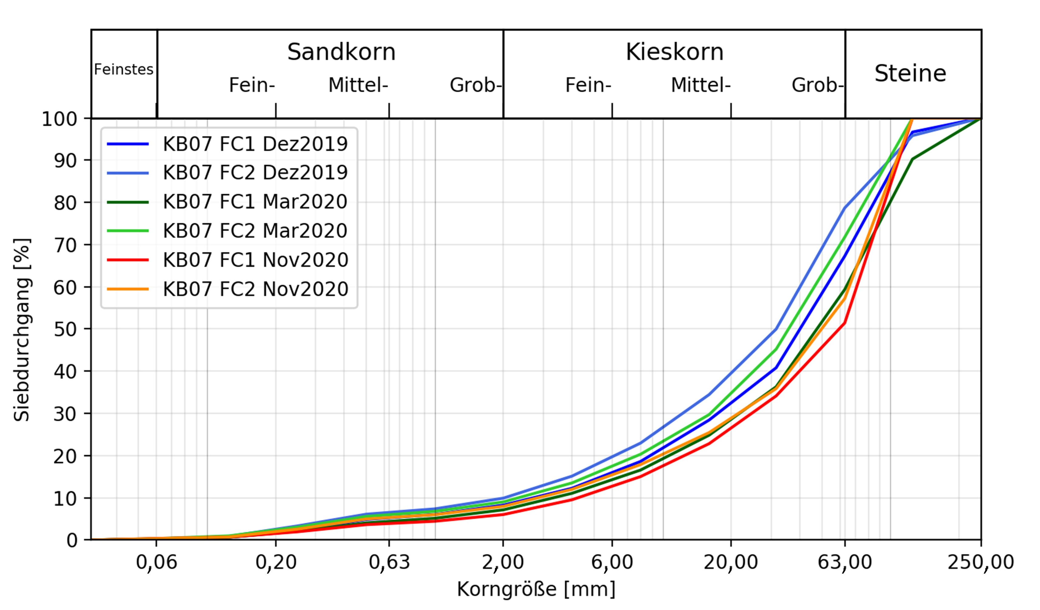
Recall: Problem Statements
Generate automated codes for grain size analysis using as input sieving datasets:
Computation of the statistical parameters.
Plotting of the cumulative grain size distribution curve for each analyzed sample.
Interactive visualization of the results:
Creation of a map where the location of the samples is shown.
Definition of the parameters that can be selected by the user for the results visualization.
Creation of the interactive plots.

Slide 4
Code Design
General description of its functionalities
Reads the sieve mesh sizes and corresponding class.
Interpolates class weights to identify the percentage finer for all grain sizes.
Computes the statistical parameters (e.g., geometric standard deviation).
StatisticalAnalyzer
StaticPlotter
Plots the cumulative grain size distribution curve per each sample.
Contains the options, comparison tools and callbacks for the upload to the web application.
Web Application
Loads the map in which the location of the collected samples is shown.
Based on the options the defined in the web application, it creates interactive plots for the results comparison.
InteractivePlotter

Slide 5
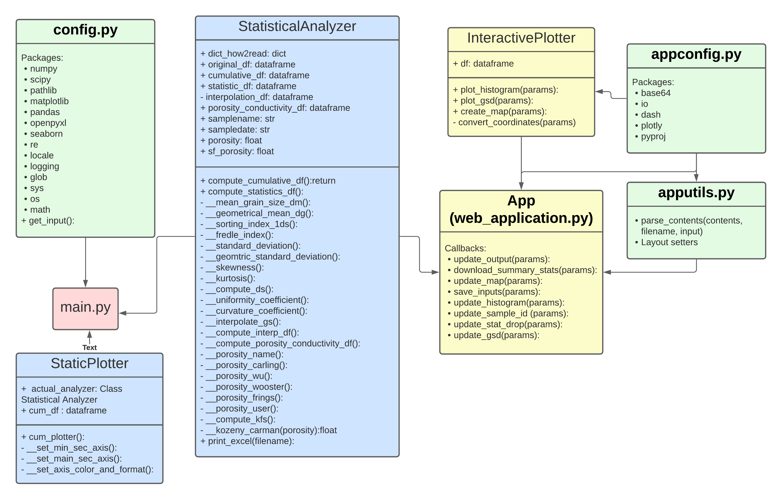
Code Structure
UML Diagram
Dependencies

Slide 6
Code Design
Planned implementation of its constituent elements
StatisticalAnalyzer
StaticPlotter
InteractivePlotter
3 Classes
Web application (GUI)
Wrapper function (callback functions from the web application)
Creation of a Python package
Log file (not confirmed yet)

Slide 7
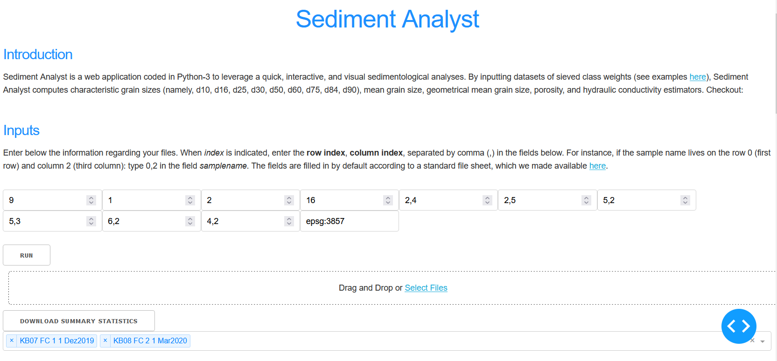
Code Design
Goals
Class for analyzing sediment sample datasets
Classes for plotting and visualizing the statistical datasets
Interactive analysis with spatial visualization

Slide 8
Timeline
Week 1
Creation of the Statistical Analyzer and Static Plotter Classes
Week 2-3
Creation of the Main Application and Interactive Plotter Classes
Week 4
Main Script and preparation of the presentation
Week 5
Code design: finalization of the diagram, debugging, README file
Week 6
Finalization of the code, docstrings, and README file
Week 7
Final revision, app deployment (online)

Slide 9



Resource Allocation
Beatriz
Federica
StaticPlotter Class
InteractivePlotter Class
StatisticalAnalyzer Class
Web Application (GUI)
Together
Main Script
Code design
README file
Presentation
Final Revision

Slide 10
Sediment grain size analyses based on sieving datasets
Thank you for your attention!
Project Framework Presentation
February 09, 2022
Beatriz Negreiros
&
Federica Scolari

